Slide 1
Mapping
Advanced Android Development
Lesson 9

Slide 2

9.1 Adding a Google Map to your app
Using the Google Maps API

Slide 3
Contents
Overview and API setup
Using GoogleMap objects
Setting the map type
Configuring initial map state
Setting map styles and lite mode
Using businesses and points of interest (POIs)
Moving the camera and view
Using map features
Listening to map events

Slide 4
Overview and API setup
Set up the project and get API keys

Slide 5
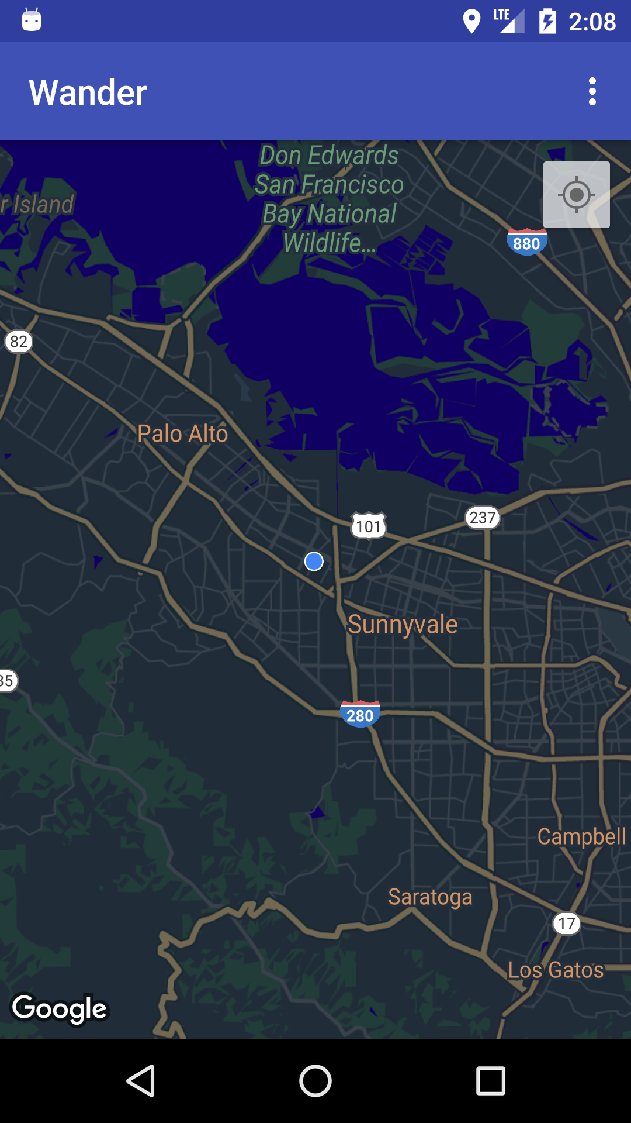
Adding a map to your app
Obtain API keys to use Google Map
Include a Google Map in your app
Change the look and feel of the map
Change map behavior

Slide 6
Register app and get API key
Register your app in Google API Console
Get debug certificate and release certificate and request API key
In Android Studio, use Google Maps Activity template
Generates boilerplate code
Provides link to obtain API key
Not using template? See API key guide

Slide 7
Obtain API debug key
Open google_maps_api.xml generated by template
Copy URL from comment and paste into browser
Follow instructions to:
Create project
Enable Maps API and obtain API debug key
Select Restrict Key to set Android restriction
Paste API key into google_maps_api.xml

Slide 8
Using GoogleMap objects

Slide 9
MapFragment for layout with fragment
MapFragment places map in fragment container
Use SupportMapFragment for backward compatibility
Use <fragment> tag in layout
android:name=
"com.google.android.gms.maps.SupportMapFragment"
Use additional map attributes mapType, cameraZoom, and more

Slide 10
MapView to use in View object
MapView places map in View
Override Activity lifecycle methods
Call corresponding MapView lifecycle methods
@Override
protected void onResume() {
super.onResume();
mMapView.onResume();
}

Slide 11
Create Google Map instance
Activity must implement OnMapReadyCallback interface and override onMapReady()
Get reference to container (MapFragment or MapView)
Use getMapAsync():
Call MapFragment.getMapAsync()for MapFragment
Call MapView.getMapAsync() for MapView
Map ready: Triggers onMapReady() with GoogleMap object

Slide 12
Setting the map type

Slide 13
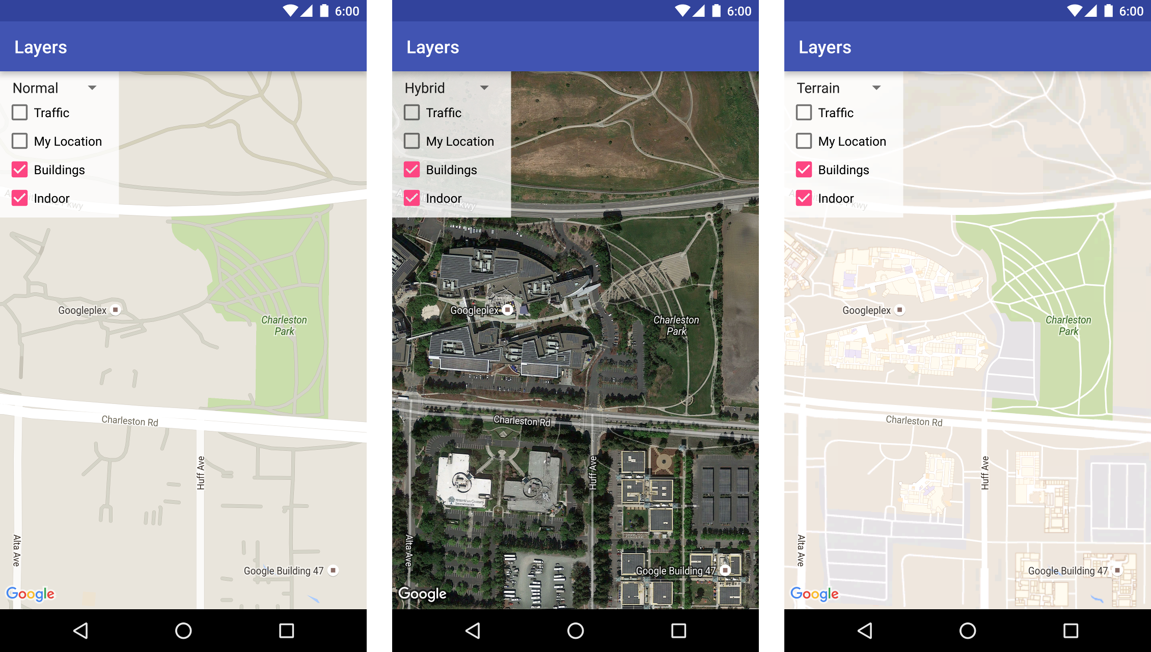
Map types
Normal: Road map
Satellite: Satellite photo
Hybrid: Satellite and roads
Terrain: Topographic data
None: No tiles
Normal
Hybrid
Terrain

Slide 14
Set map type
Call setMapType() with GoogleMap type constant
Example of setting to "hybrid" type:
GoogleMap map;
// Sets the map type to "hybrid"
mMap.setMapType(GoogleMap.MAP_TYPE_HYBRID);

Slide 15
Configuring initial map state

Slide 16
Configuring initial map state
Camera position, including location, zoom, bearing, and tilt
Map type
Whether zoom buttons appear and/or compass appears
Gestures to manipulate map
Enable lite mode (bitmap image with subset of functions)
Define map state using XML attributes, or in code

Slide 17
Define map state in XML
Add namespace declaration to Fragment or View
xmlns:map="http://schemas.android.com/apk/res-auto"
Custom XML attributes for MapFragment or MapView

Slide 18
Custom XML attributes
Custom XML attributes for MapFragment or MapView
mapType, liteMode
cameraTargetLat, cameraTargetLng, cameraZoom, cameraBearing, cameraTilt
uiZoomControls, uiCompass, uiZoomGestures, uiScrollGestures, uiRotateGestures, uiTiltGestures
zOrderOnTop
useViewLifecycle

Slide 19
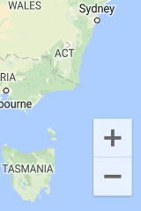
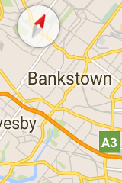
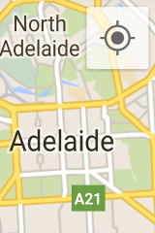
Custom XML attributes
Zoom controls
Compass
Location button

Slide 20
Using XML example (part 1)
<fragment
xmlns:android="http://schemas.android.com/apk/res/android"
xmlns:map="http://schemas.android.com/apk/res-auto"
android:name=
"com.google.android.gms.maps.SupportMapFragment"
android:id="@+id/map"
android:layout_width="match_parent"
android:layout_height="match_parent"
map:cameraBearing="112.5"
map:cameraTargetLat="-33.796923"
...

Slide 21
Using XML example (part 2)
...
map:cameraTargetLng="150.922433"
map:cameraTilt="30"
map:cameraZoom="13"
map:mapType="normal"
map:uiCompass="false"
map:uiRotateGestures="true"
map:uiScrollGestures="false"
map:uiTiltGestures="true"
map:uiZoomControls="false"
map:uiZoomGestures="true"/>

Slide 22
Define map state in code
Use constructors
MapFragment: MapFragment.newInstance(GoogleMapOptions options) static factory method
MapView: MapView(Context, GoogleMapOptions)
Configure initial state by passing in a GoogleMapOptions object with options (same as XML attributes)

Slide 23
Configuring with GoogleMapOptions
Create GoogleMapOptions object
GoogleMapOptions options = new GoogleMapOptions();
Configure initial state
options.mapType(GoogleMap.MAP_TYPE_SATELLITE)
.compassEnabled(false)
.rotateGesturesEnabled(false)
.tiltGesturesEnabled(false);

Slide 24
Setting map styles and lite mode

Slide 25
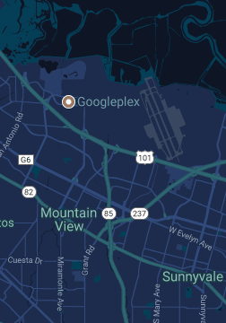
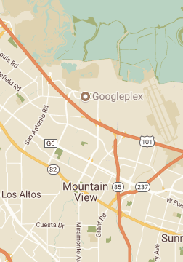

Map styles
You can change the style of your maps

Slide 26
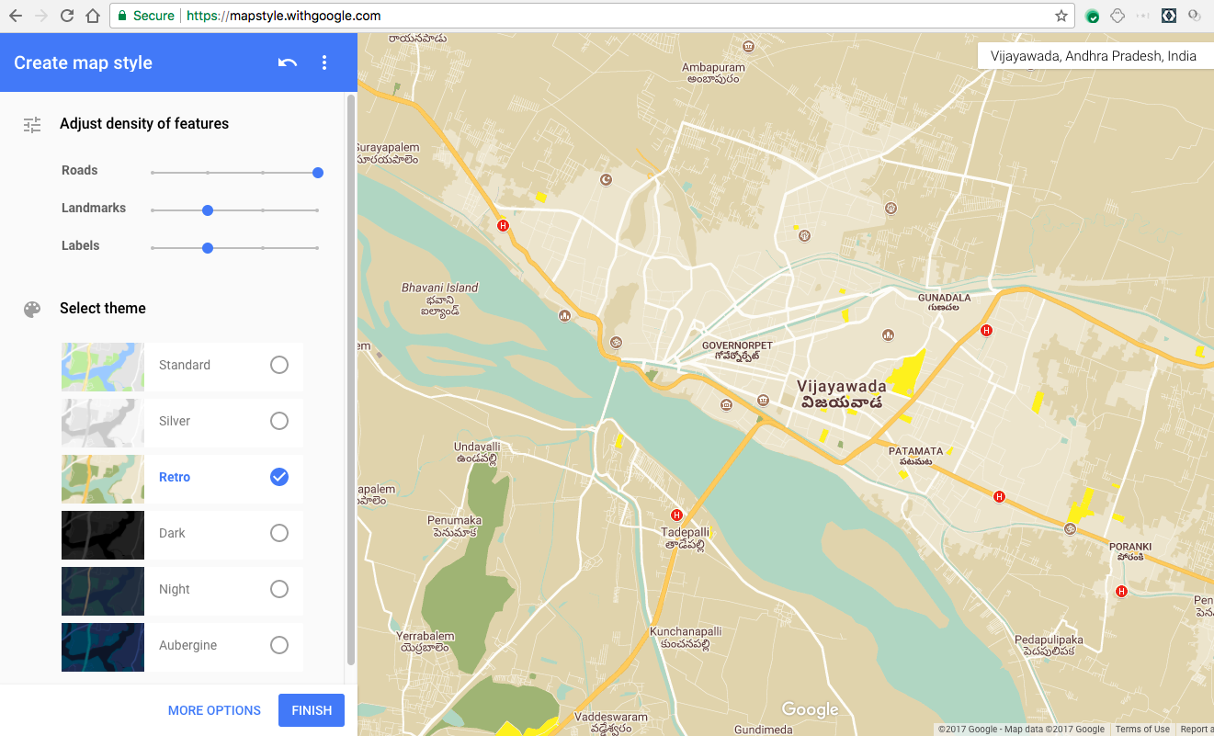
Use style wizard to get styles
mapstyle.withgoogle.com

Slide 27
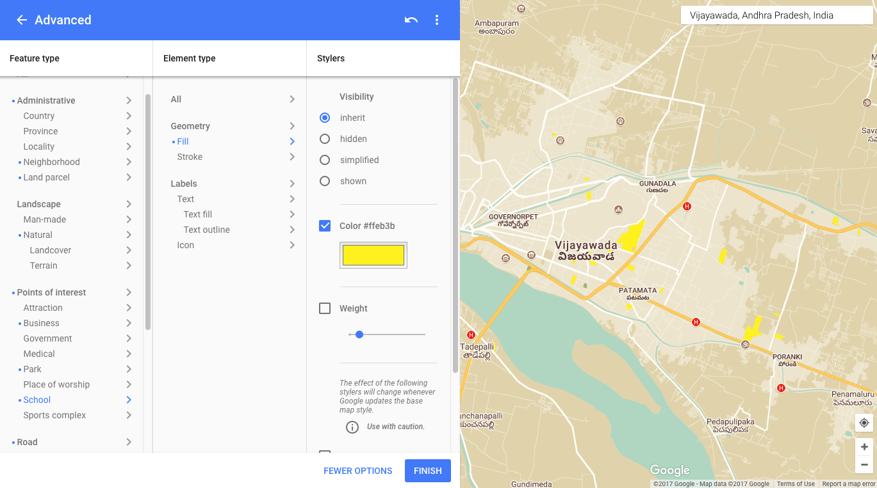
Use style wizard to get styles
More options

Slide 28
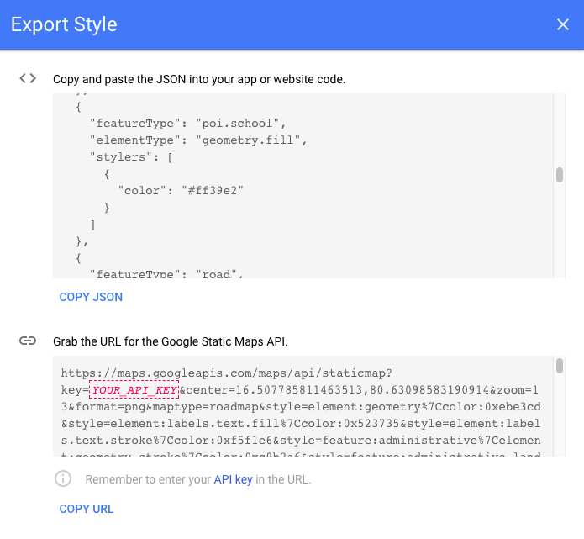
Get style as JSON
Style wizard generates JSON file

Slide 29
Styling a map
Change display of features
Normal map type only
No effect on indoor map
Style changes
Select geographic components (roads, parks, etc.)
Set styles for color and visibility properties
See style reference for JSON styling options

Slide 30
Steps to styling a map
Use style wizard to generate style
Save JSON file in raw resource directory
Call GoogleMap.setMapStyle() passing in a MapStyleOptions object that loads resource

Slide 31
Using GoogleMap.setMapStyle()
try {
// Customize styling of map using a JSON object defined
// in a raw resource file.
boolean success = googleMap.setMapStyle(
MapStyleOptions.loadRawResourceStyle(this, R.raw.map_style));
if (!success) {
Log.e(TAG, "Style parsing failed.");
}
} catch (Resources.NotFoundException e) {
Log.e(TAG, "Can't find style file. Error: ", e);
}

Slide 32
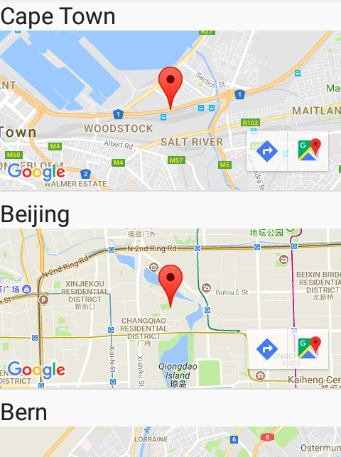
Lite mode
All map types with subset of full API
Useful for list of maps or small map without interaction
No zoom or pan
Icons for viewing in Google Maps app and requesting directions

Slide 33
Implementing lite mode
Set Google Map to lite mode in XML:
map:liteMode="true"
Or set in GoogleMapOptions object:
GoogleMapOptions options = new GoogleMapOptions().liteMode(true);

Slide 34
Businesses and points of interest

Slide 35
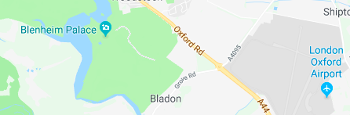
Points of interest
Points of interest
Attraction
Business
Government
Medical
Park
Place of worship
School
Sports complex

Slide 36
Businesses and points of interest (POIs)
POI corresponds to place defined in Google Places API
Base map: POIs appear by default
Normal map type: Businesses and POIs by default
Respond to POI click and display info window with OnPoiClickListener

Slide 37
Steps to use OnPoiClickListener
Set OnPoiClickListener in onMapReady()
GoogleMap.setOnPoiClickListener(OnPoiClickListener)
When user taps POI, app receives onPoiClick(PointOfInterest) event
Get latitude/longitude coordinates, place ID, and name of POI from PointOfInterest received from event

Slide 38
GoogleMap.OnPoiClickListener
public class OnPoiClickDemoActivity extends
FragmentActivity implements OnMapReadyCallback,
GoogleMap.OnPoiClickListener {
@Override
protected void onCreate(Bundle savedInstanceState) {
super.onCreate(savedInstanceState);
setContentView(R.layout.poi_click_demo);
SupportMapFragment mapFragment = (SupportMapFragment)
getSupportFragmentManager()
.findFragmentById(R.id.map);
mapFragment.getMapAsync(this);
}

Slide 39
onPoiClick() example
@Override
public void onMapReady(GoogleMap map) {
map.setOnPoiClickListener(this);
}
@Override
public void onPoiClick(PointOfInterest poi) {
Toast.makeText(getApplicationContext(), "Clicked: " +
poi.name + "\nPlace ID:" + poi.placeId + "\nLatitude:" +
poi.latLng.latitude + " Longitude:" + poi.latLng.longitude,
Toast.LENGTH_SHORT).show();
}

Slide 40
Moving the camera and view

Slide 41
Camera and view
Change user's view by modifying map's camera
OnMapClickListener.onMapClick() receives latitude and longitude
Your app can zoom camera to that point
Other examples
Responding to tap on marker bubble
Responding to drag gesture on marker

Slide 42
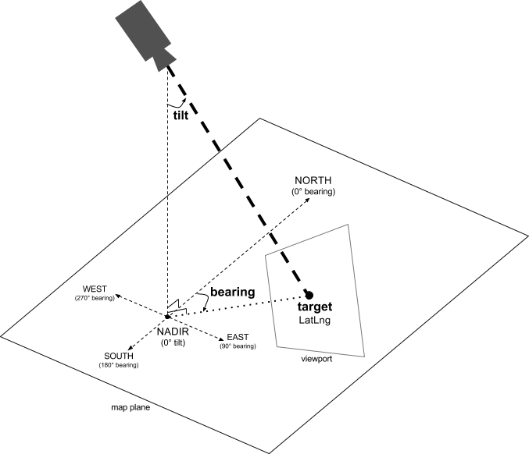
Camera position
Camera position specified by:
Target location
Bearing
Tilt
Zoom

Slide 43
Camera position aspects
Target (location): center of map latitude/longitude location
Bearing (orientation): vertical line direction measured in degrees clockwise from north
Tilt (viewing angle): perspective
Zoom: Scale of map

Slide 44
Steps for moving the camera
Create float variable zoom set to desired initial zoom level
1: World
5: Landmass/continent
10: City
15: Streets
20: Buildings
Pan and zoom with CameraUpdateFactory.newLatLngZoom()
mMap.moveCamera(CameraUpdateFactory.newLatLngZoom(home, zoom));

Slide 45
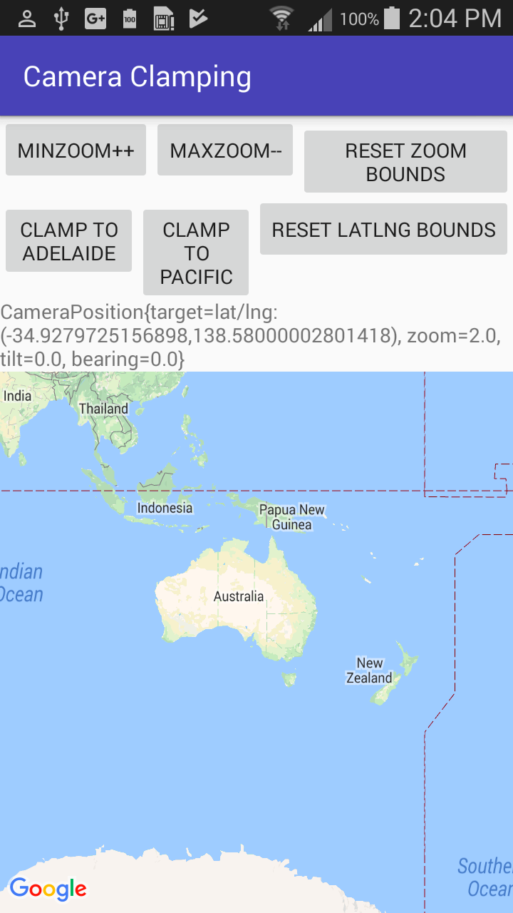
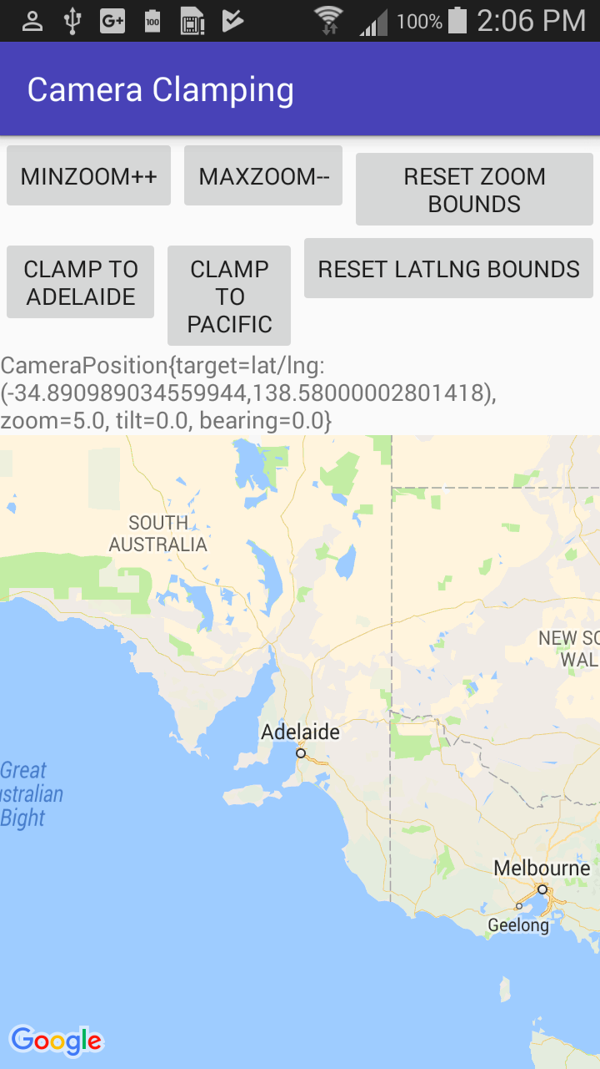
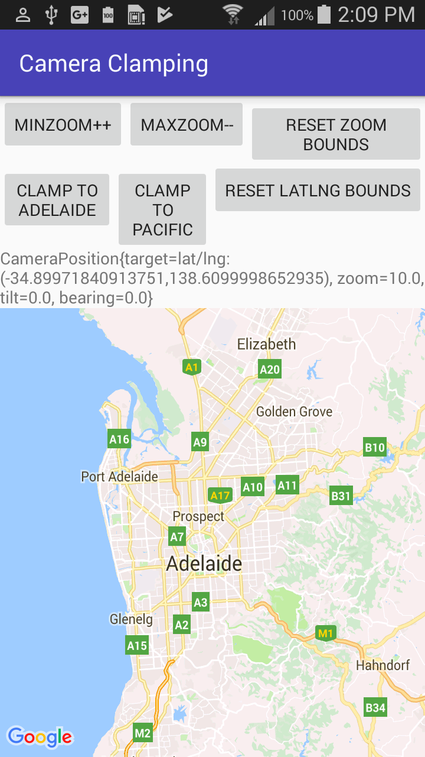
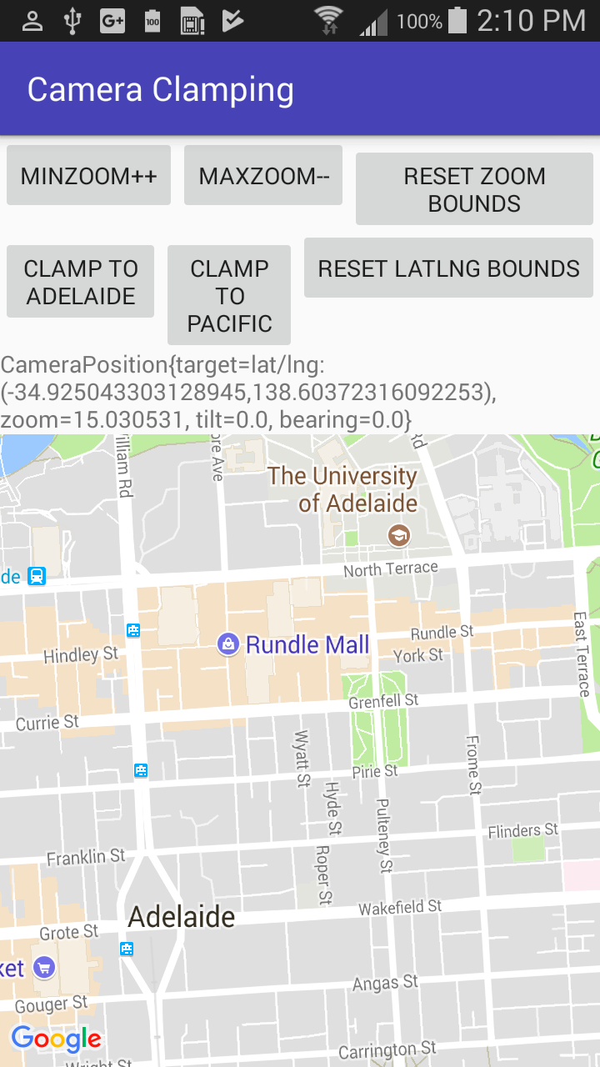
Zoom levels
Zoom level 2.0
Zoom level 5.0
Zoom level 10.0
Zoom level 15.0

Slide 46
Using map features

Slide 47
Map features
Map markers
Controls and gestures
Indoor maps
Info windows
Shapes
Ground and tile overlays
Street View

Slide 48
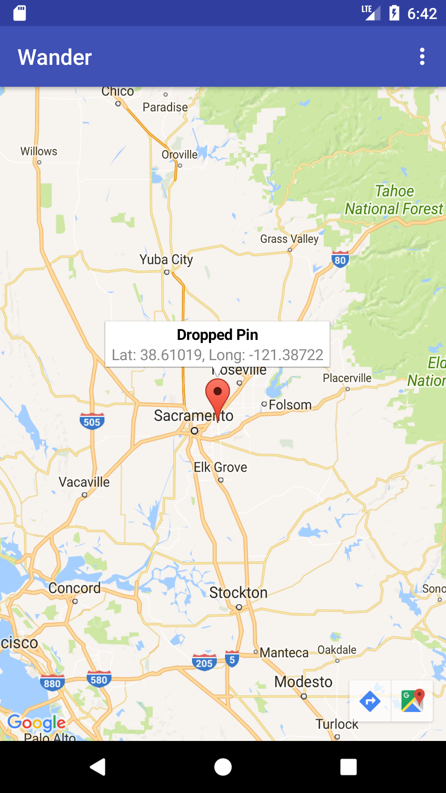
Using map markers
Change marker color, image, or anchor point
Add Marker objects
GoogleMap.addMarker(markerOptions)

Slide 49
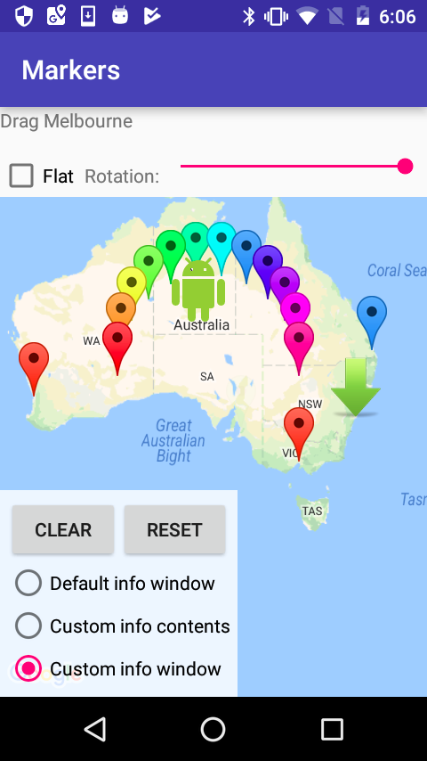
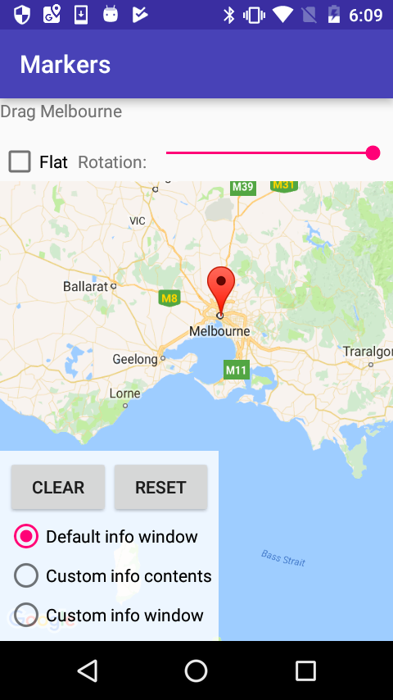
Using map markers
Customized markers
Default marker

Slide 50
Map marker click events
Markers receive click events by default
On tap, map toolbar appears in lower right
Often used with event listeners (OnMarkerClickListener)
Default info window appears at top
Set draggable property to true to allow user to change position

Slide 51
Adding a marker
GoogleMap object has setOnMapLongClickListener() to place marker at location of touch & hold
Pass in new instance of OnMapLongClickListener and override onMapLongClick()
Incoming argument is LatLng with coordinates
Add marker with GoogleMap.addMarker()
See Markers for details

Slide 52
Adding a marker example
Set OnMapLongClickListener to map object
map.setOnMapLongClickListener(new
GoogleMap.OnMapLongClickListener() {
@Override
public void onMapLongClick(LatLng latLng) {
map.addMarker(new
MarkerOptions().position(latLng));
}
});

Slide 53
UI controls
Toggle visibility of UI controls using UiSettings obtained from a GoogleMap with GoogleMap.getUiSettings()
Enable/disable zoom control with UiSettings.setZoomControlsEnabled(boolean)
Enable/disable compass with UiSettings.setCompassEnabled(boolean)
Enable/disable toolbar with UiSettings.setMapToolbarEnabled(boolean)

Slide 54
Gestures
Enable/disable zoom gestures with UiSettings.setZoomGesturesEnabled(boolean)
Enable/disable scrolling/panning with UiSettings.setScrollGesturesEnabled(boolean)
Enable/disable tilt gestures with UiSettings.setTiltGesturesEnabled(boolean)
Enable/disable rotation with UiSettings.setRotateGesturesEnabled(boolean)

Slide 55
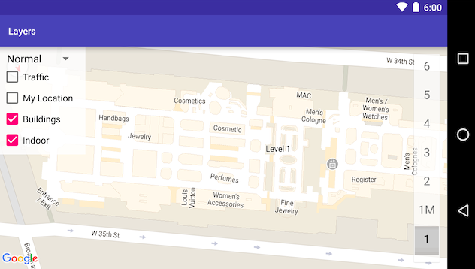
Indoor maps
Floor plans for indoor spaces

Slide 56
Indoor maps
Floor plans for indoor spaces
Auto enabled when user zooms in, fades when user zooms out
For "normal" and "satellite" map types
Floor plans available in select locations, and you can
Add floor plans (available to all Google Maps)
Display a floor plan as ground overlay or tile overlay

Slide 57
Indoor map actions
setIndoorEnabled(false) – Disable indoor maps
getUiSettings().setIndoorLevelPickerEnabled(false) – Disable level picker control
GoogleMap.getFocusedBuilding() – Get building in focus
IndoorBuilding.getActiveLevelIndex() – Find active level
...and more. See IndoorBuilding and IndoorLevel.

Slide 58
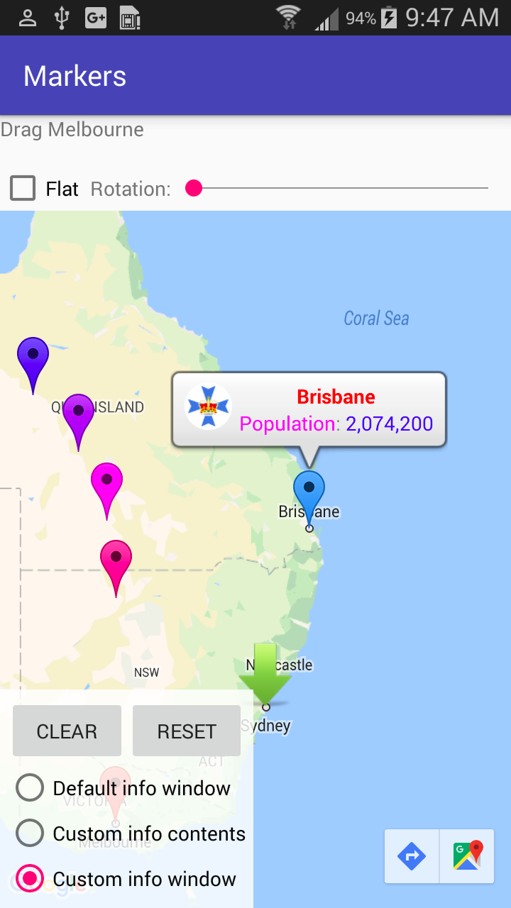
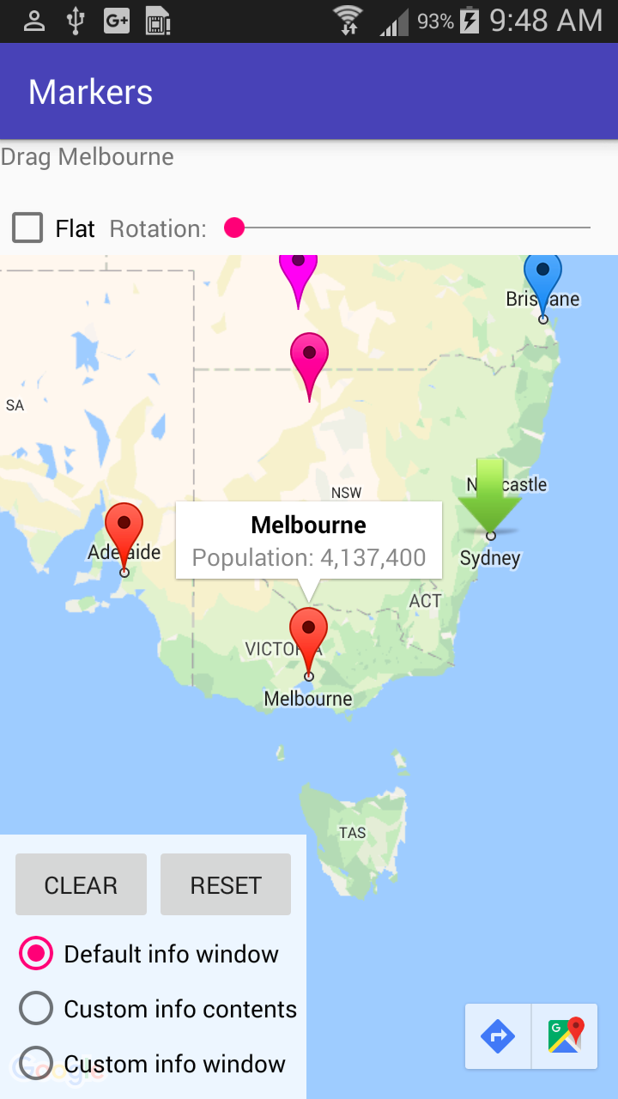
Info windows
Customized info window
Default info window

Slide 59
Customize the info window
Create implementation of InfoWindowAdapter interface
Call GoogleMap.setInfoWindowAdapter() with your implementation
Implement InfoWindowAdapter .getInfoWindow(Marker) for custom info window

Slide 60
Customize info window contents
Implement InfoWindowAdapter.getInfoContents(Marker) to customize just the content of info window
If getInfoWindow(Marker) returns null, API calls getInfoContents(Marker)
If getInfoContents(Marker) returns null, API uses default info window

Slide 61
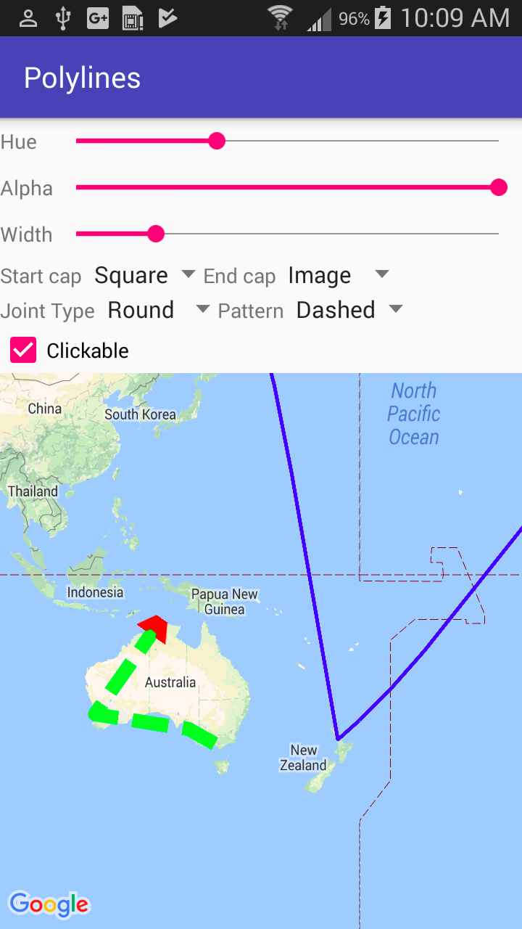
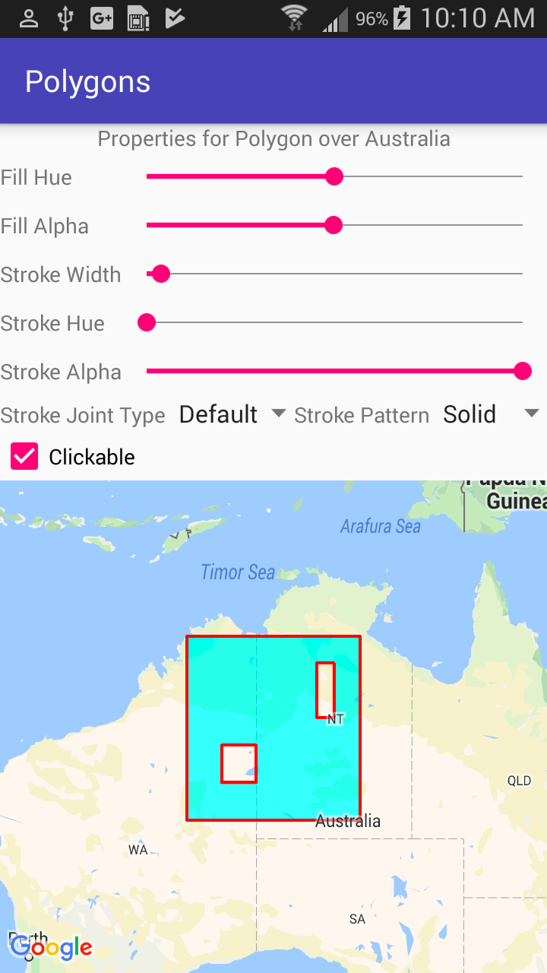
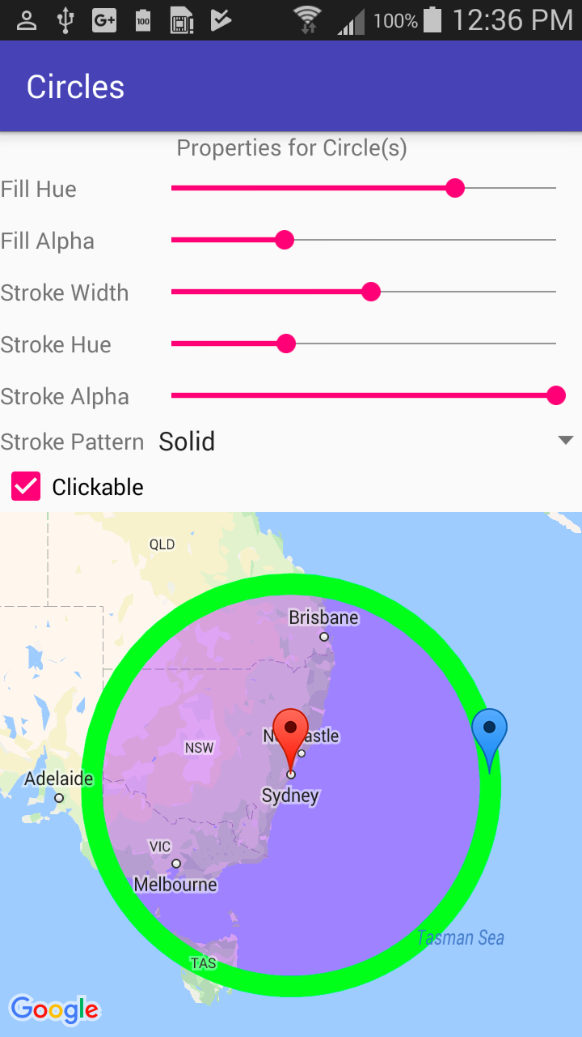
Draw shapes over map
Polylines
Polygons
Circle

Slide 62
Draw shapes over map
Polyline: Series of connected line segments for paths and routes
Polygon: Enclosed shape to mark map areas
Circle: Geographically accurate projection of a circle on Earth's surface
Properties: See Shapes

Slide 63
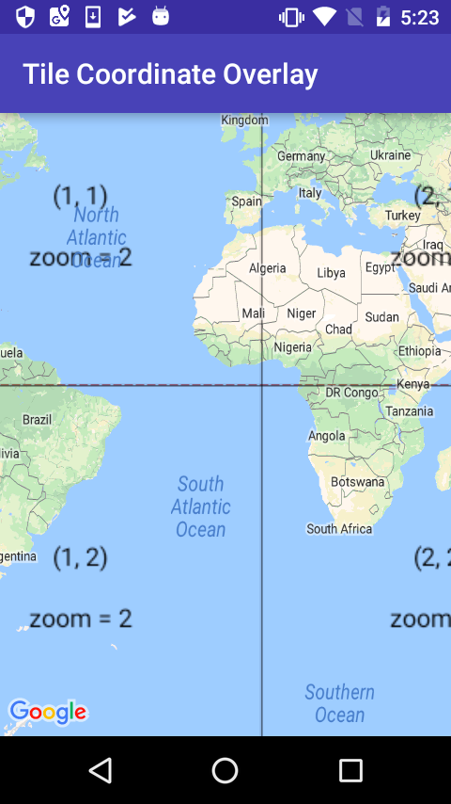
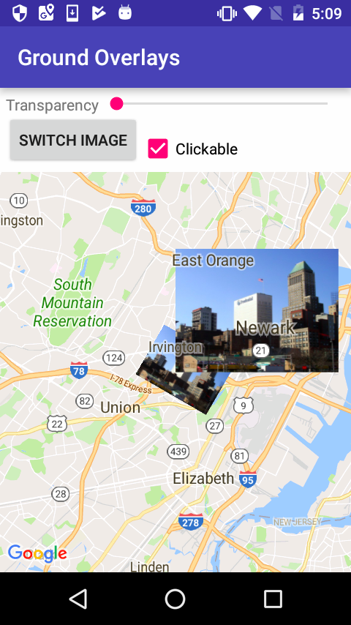
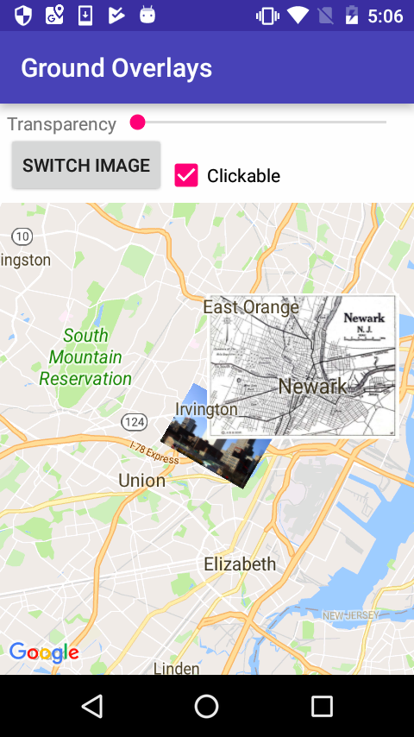
Use ground and tile overlays
Ground overly: Image fixed on map at specific point
Tile overlay: Set of images added on top of base map tiles
Ground overlays
Tile overlays

Slide 64
Adding a ground overlay
Create GroundOverlayOptions and use BitmapDescriptorFactory.fromResource()
Set the position property:
GroundOverlayOptions homeOverlay = new
GroundOverlayOptions()
.image(BitmapDescriptorFactory
.fromResource(R.drawable.android))
.position(home, 100);
Call addGroundOverlay():
mMap.addGroundOverlay(homeOverlay);

Slide 65
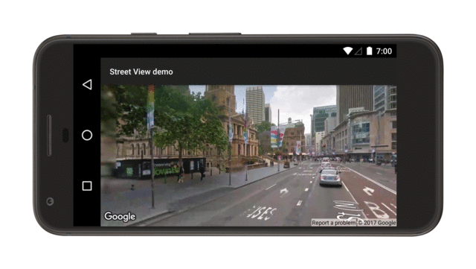
Google Street View

Slide 66
Google Street View
StreetViewPanorama models 360-degree panorama (see Street View for locations)
StreetViewPanoramaFragment for fragment
StreetViewPanoramaView for view
Configure the panorama
StreetViewPanoramaFragment
.newInstance(StreetViewPanoramaOptions options)
StreetViewPanoramaView(Context, StreetViewPanoramaOptions)

Slide 67
Listening to map events

Slide 68
Listening to map events
Map click or map touch & hold
Camera change
Business or point of interest (POI)
Indoor map
Marker and info window
Shape and overlay
For details see Events

Slide 69
What's next?
Concept chapter: 9.1 Google Maps API
Practical: 9.1 Add a Google Map to your app

Slide 70
END

